Slide 1
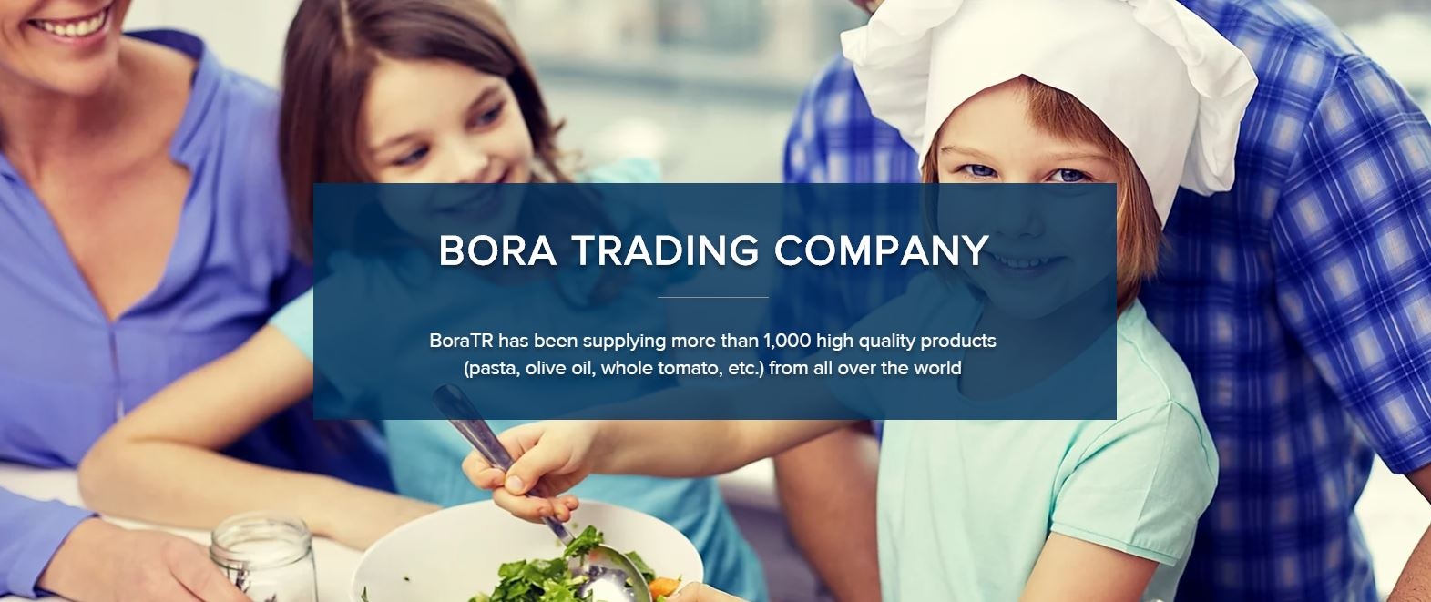

Slide 2
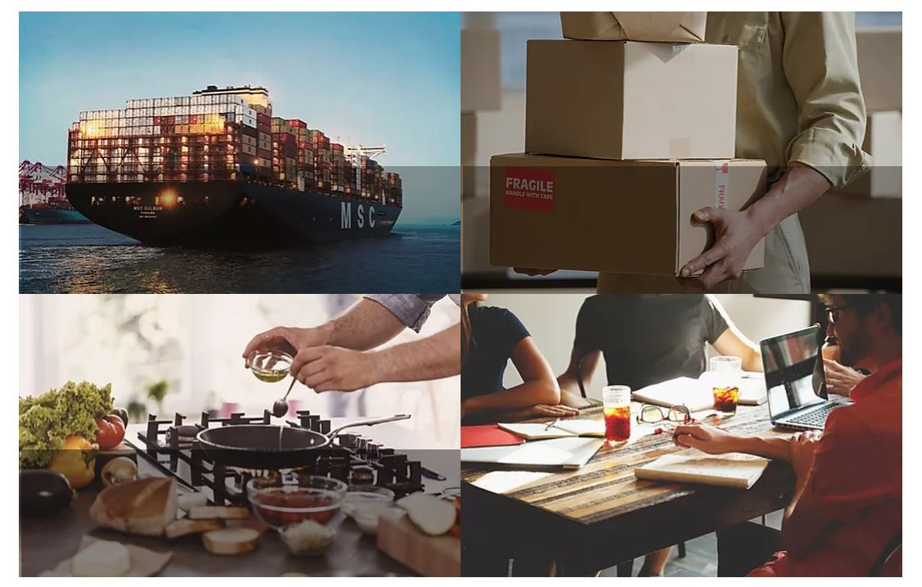
WHAT WE DO
Global Sourcing
& Import
Import the high quality foods and brands selected from many countries
Retail
Distribute to online store, department store, wholesale, enterprise, hotel, restaurant, cafe, manufacture, etc.
HMR
Develop Home Meal Replacement foods to satisfy the change in customers’ need
New Business

Slide 3
ABOUT US
01. BoraTR is a general food company.
We began in 1996 as an Italian food importer. Now we import and deliver food from all over the world. We are a leading food importer and retailer, dealing with the products from Italy, France, Spain, Turkey, and many others.
​
Our company strives to improve culinary standard. We pick only the highest quality products from over 80 companies. We import and deliver over 1,000 products including pasta, whole tomato, olive oil, dairy products, and meat.
We have recently expanded our business to Home Meal Replacement (HMR).

Slide 4
ABOUT US
02. BoraTR values customer satisfaction
We value customer satisfaction as our top priority.
We develop and provide new recipes and products catered to our customer’s needs.
​
We do our best to improve the value of individual brands, striving to bring Western cuisine in a way that seamlessly fit the Korean dining culture.
03. BoraTR is GWP
We hire talented individuals, focus on their self-development, and evaluate them according to achievement.
​
We provide a self-driven working environment to bring about the best in all our employees.
Based on individual’s need, our employees can choose to work from home or at the office freely.

Slide 5
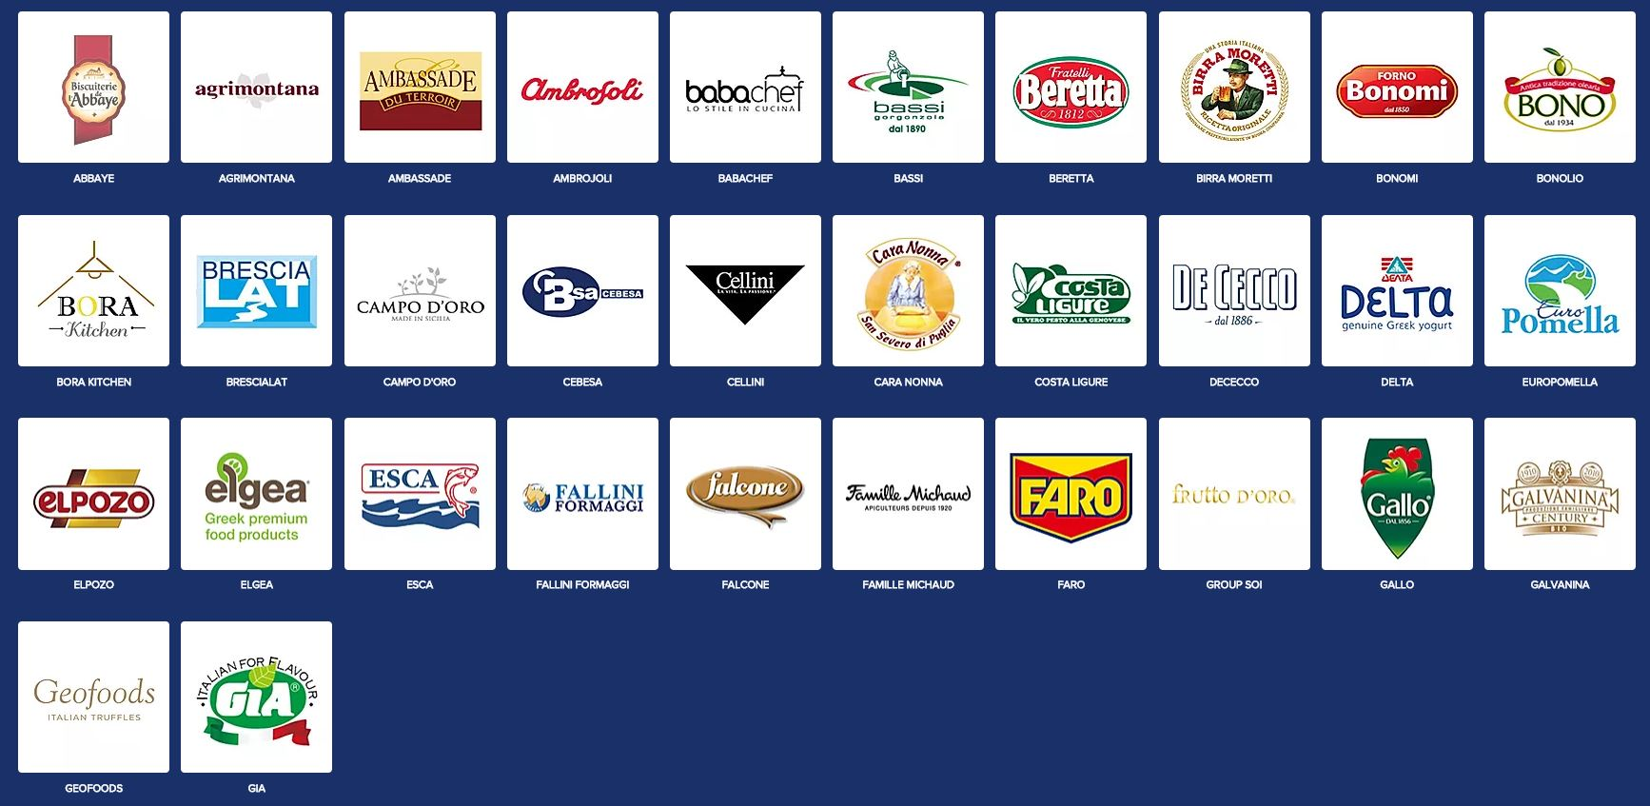
OUR BRANDS
A-J

Slide 6
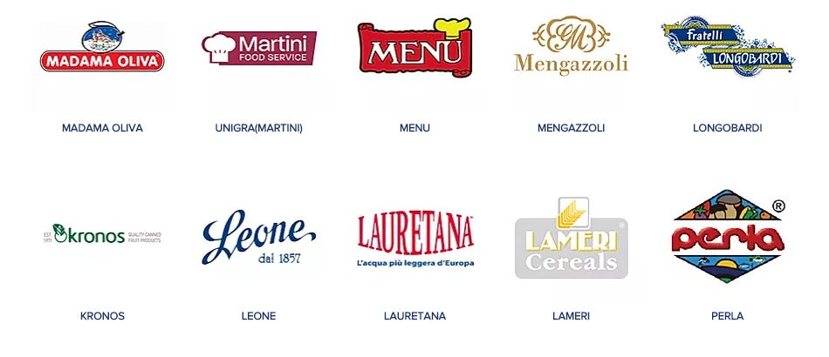
OUR BRANDS
K-T

Slide 7
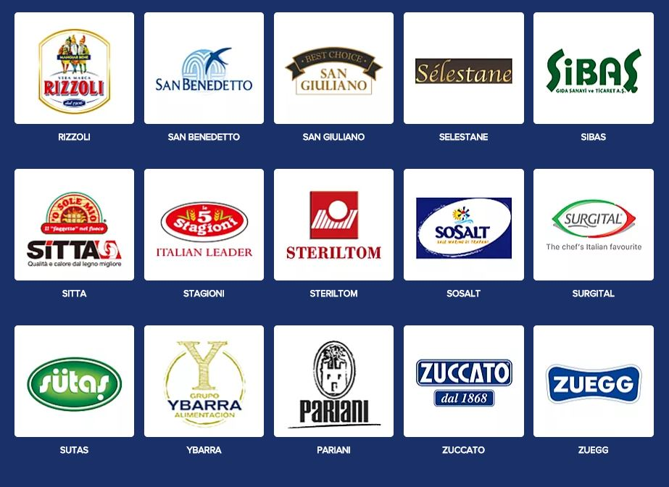
OUR BRANDS
U-Z

Slide 8
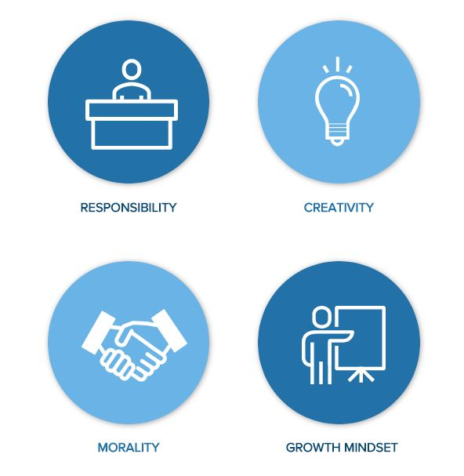
WE ARE GROUP OF PEOPLE WITH

Slide 9
RECRUITMENT
BoraTR believes that excellent talent is the most important asset to our company.
​
We are always looking for the talented individuals (team members, team leaders, executives) who have experience in the food industry.
​
      • Accounting
      • Trade (sourcing, ordering, clearance)
      • Sales (online, department store, wholesale, hotel, restaurant, cafe, manufacturing, etc.)
      • Logistics
      • Sales/ CM
​
Please submit your resume to hr@boratr.co.kr if you are interested.
Our HR will be in touch for those who pass the document screening.

